Slide 1

Duplicate SN System
PQA:Susie

Slide 2
Content
一
一
一
Duplicate SN System introduction &SFIS control logic
二
二
二
Duplicate SN System log in
三
三
Duplicate SN System interface introduction
四
Pull out the data from Duplicate SN System
五
Duplicate SN units transfer and confirmation step
六
the return for Duplicate SN

Slide 3
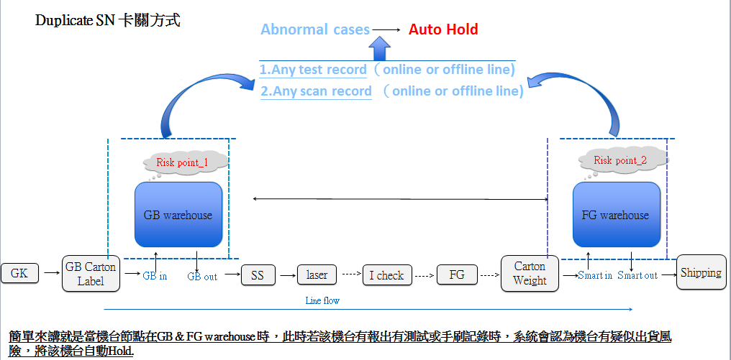
一.Duplicate SN System introduction&SFIS control logic
Duplicate SN System爲重複機台sn確認的廠區資訊整合系統,此系統針對GB/FG重複刷到的雙胞胎機台與機台混放禮盒流程之資料收集與整合新開發系統,具有資源追蹤,即時分析,流程管理 .等等管控異常機台功能.
it is a system for duplicated SN confirmation, we can use it to track twin units with same FG/FB label or unit mixed in wrong box issue. we can quickly find out those abnormal units, do analysis and process control.
Duplicate sn system control logic

Slide 4
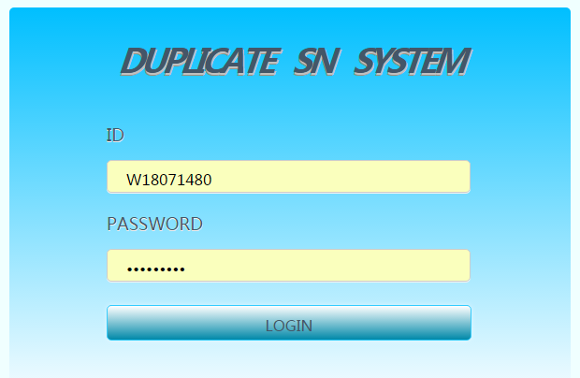

二.log in the system
Here is the web link:
http://172.28.129.195/duplicate/index.php
just log in with ID and password
工号
密码

Slide 5
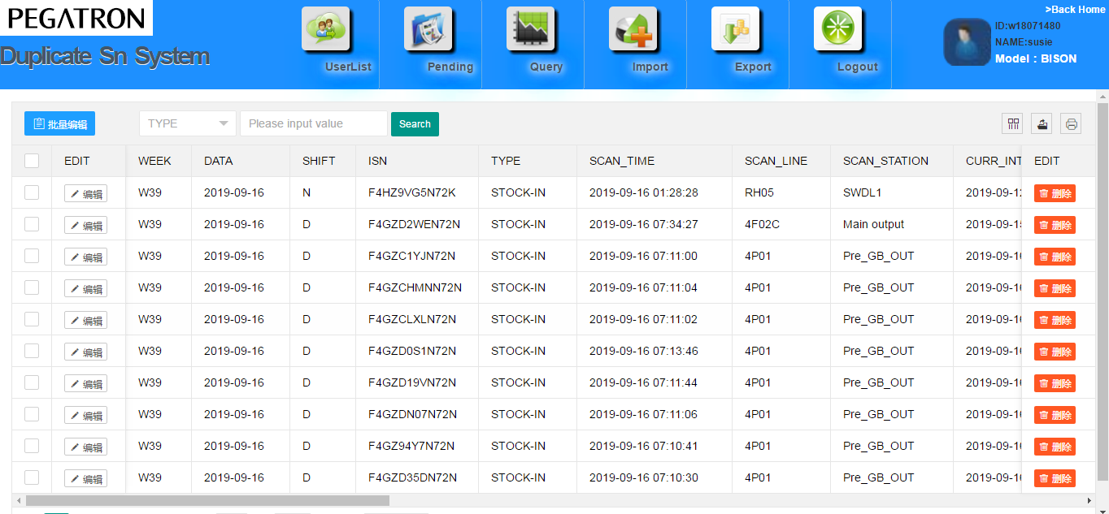
三. Duplicate SN System interface introduction
under confirmation

Slide 6
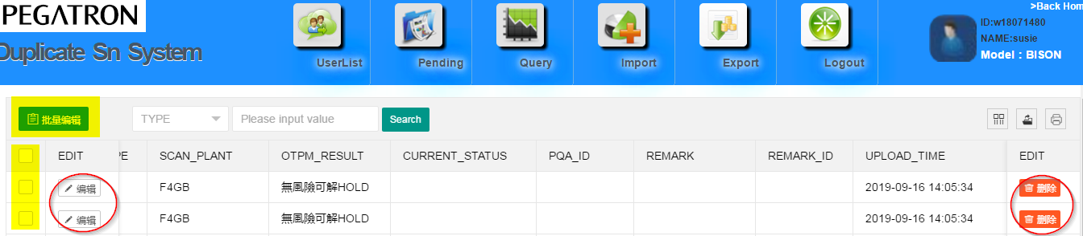
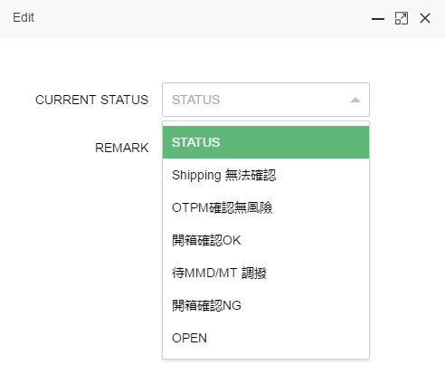
三. Duplicate SN System interface introduction
delete info
Note: Pending interface, click EDIT, then show the info as left PIC, based OTPM provided result and category of station point to edit/modify details.
click the yellow part, can edit many info at one time.

Slide 7
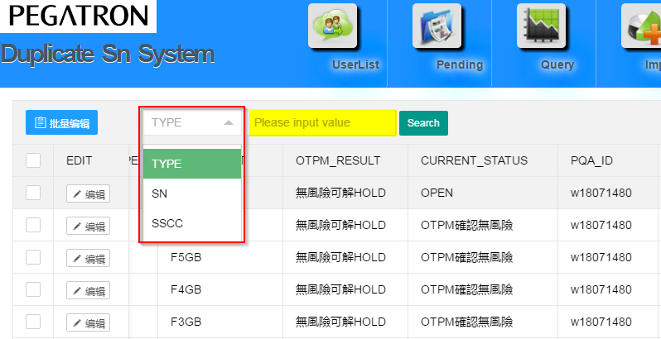
三. Duplicate SN System interface introduction
input SN/SSCC in following yelow part of pending interface, you can check the unit status(hold or unhold)
Input SN/SSCC

Slide 8
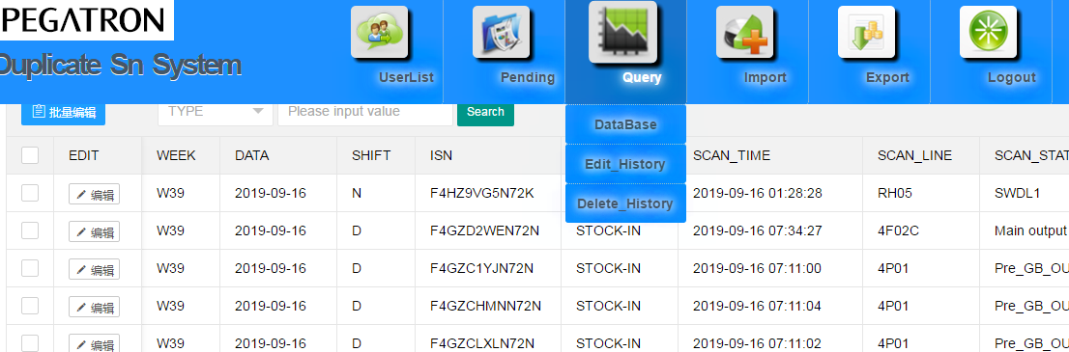
三. Duplicate SN System interface introduction

Slide 9
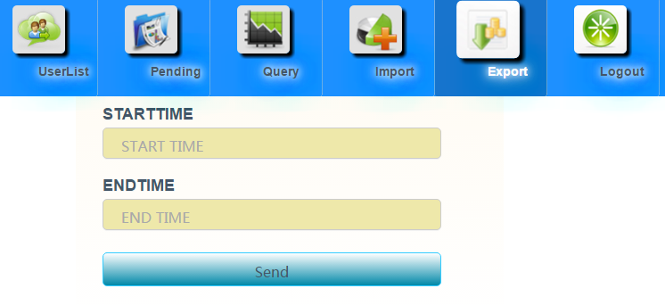
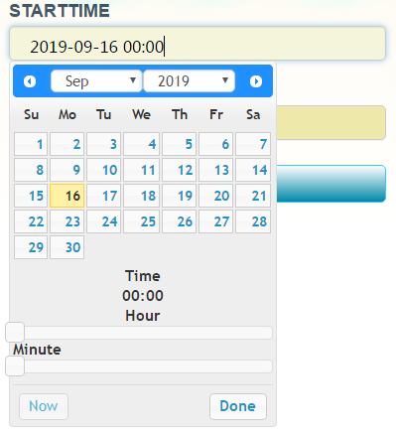
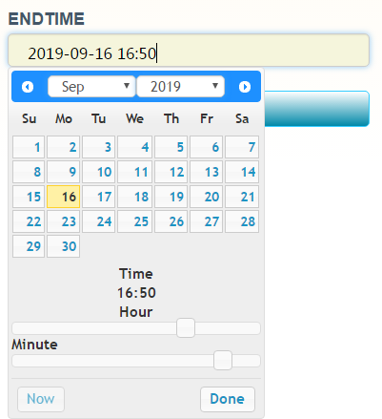
三. Duplicate SN System interface introduction
click and choose the start time
click and choose the end time
Note: [Export] START TIME is before END TIME, click send and pull out the data

Slide 10
四.Pull out the data from Duplicate SN System
PS: CUT TIME-24hours, check and summary the data.

Slide 11
五. Duplicate SN units transfer and confirmation step
1. Open the carton box and check step

Slide 12
六.the return for Duplicate SN a.after confirmation for risk units, Pack team pick up the units from CP area, reprint the barcode for assessory KP, then ask PQA team to rework it to S/S station,remove the linked KP: AT.CL.HT.WSI.LAC(chinese units). b.if the abnormal unit is already shipped out, PACK team will report it to boss and ask for instructions

Slide 13

Thank You ！

